Slide 1
Data Visualisation for Business ANL 201
Science and Art of Data Visualisation Study Unit 2
January 2023

Slide 2
Recap Overview of Business Performance Measurements
Business Performance Measurement- Definition, Performance Metrics, and importance of metrics
The Four Balanced Scorecard Perspectives
Strategy Map
Vision, Mission, Strategic Themes, Strategic Objectives, Measure, Target, Initiatives

Slide 3
Data Visualisation

Slide 4
What is Data Visualisation?
Data - facts and statistics used for reference or analysis
Visualisation - the graphical representation of data
Data visualisation” refers to transforming figures and raw data into visual objects: points, bars,“ line plots, maps, etc. “Data visualization is the art of depicting data in a fun and creative way, beyond the possibilities of Excel tables.
Charles Miglietti, an expert in data visualization and co-founder of Toucan Toco
https://youtu.be/VyhLRJVoIrI

Slide 5
Benefits of Data Visualisation
Provides us the ability to comprehend huge amounts of data
Allows the perception of emergent properties that are not anticipated
Facilitates hypothesis formation
Often enable problems with data to become immediately apparent
Notes:
visualised data is processed faster by the human brain
Identify trends
shows insights that may be missed in traditional report
gives actionable items

Slide 6
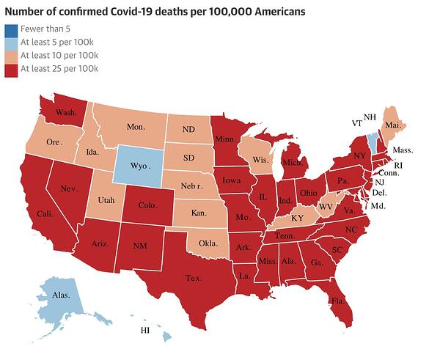
Data Visualisation - Data visualisation in everyday life
https://blog.hubspot.com/marketing/great-data-visualization-examples

Slide 7
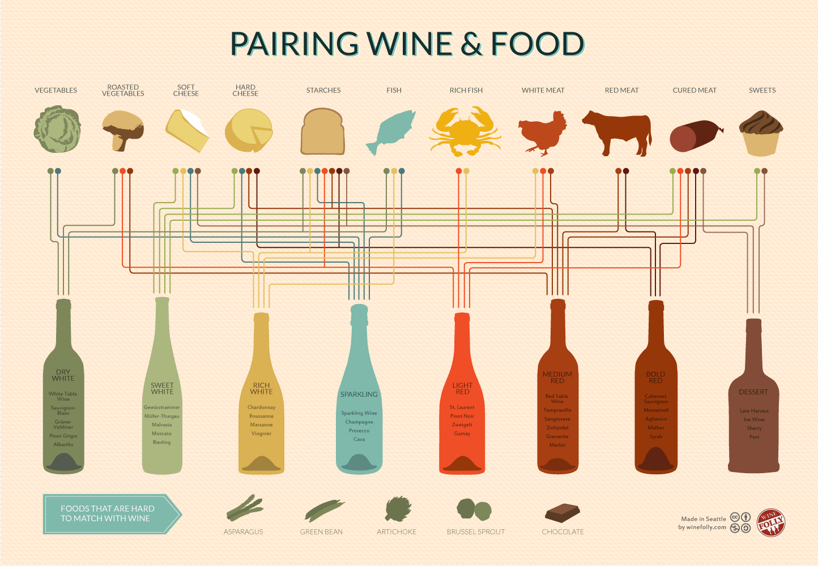
Data Visualisation - Data visualisation in everyday life
https://www.toucantoco.com/en/blog/7-examples-of-data-visualization

Slide 8
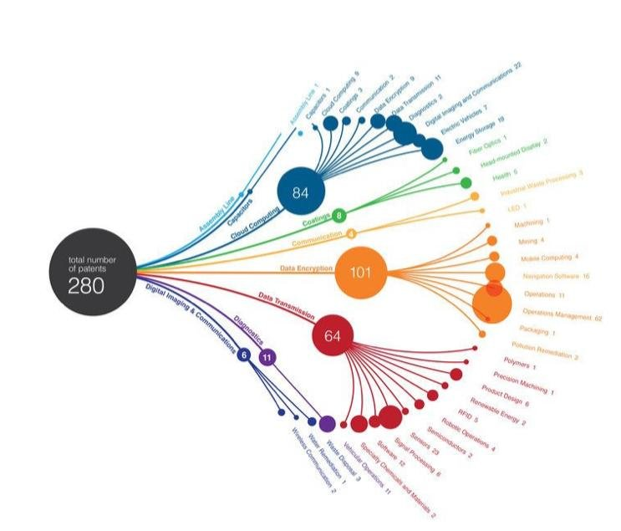
Data Visualisation - Data visualisation in everyday life
https://www.researchgate.net/topic/Data-Visualization

Slide 9
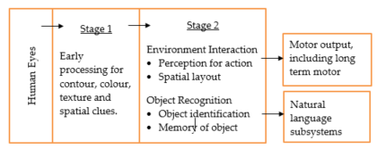
Perceptual Processing Model
Overview of a two-stage model of human visual information processing (Ware, 2013)
Notes:
Stage 1: Parallel processing to extract low-level properties of the visual scene
Visual information is first processed by large arrays of neurons in the eye, and in the primary visual cortex at the back of the brain. Individual neuron is selectively tuned to certain kinds of information, such as the orientation of edges or the colour of a patch of light. In each subarea, large arrays of neurons work in parallel, extracting particular features of the environment. In the early stages, this rapid parallel processing proceeds whether we like it or not. It is largely independent of what we choose to attend to, not where we look at. If we want people to understand information quickly, we should present it in such a way that it can easily be detected by these large, fast computational systems of the brain.
Stage 2: Sequential goal-directed processing
The second stage is divided into two separate parts – a subsystem specialised in object recognition, and a subsystem specialised in interacting with the environment. To identify an object, people must match the object’s visual characteristics with properties of the object stored in their memories. In addition, the task that the observer is performing will also influence what is perceived. One of the primary mechanisms relating what is perceived to the task is visual attention. Some aspects of the second stage processing occur sequentially where one visual object is processed at one time.
There is increasing evidence that tasks involving eye-hand coordination and locomotion may be processed in pathways distinct from those involved in object recognition. Milner and Goodale (1995) suggested two-visual-system hypotheses: one system for locomotion and action, another for symbolic object manipulation.
A number of theorists suggests that there is an intermediate representation of the world at the boundary between Stage 1 and Stage 2 processing. Marr (1982) called this the sketch. Triesman (1980) called it a feature map. But much is still unknown about how visual objects are constructed from features, memories and the locus of visual attention.
Beyond the visual processing stages shown in Figure 2.6 are interfaces of other subsystems. A visual object recognition process interfaces with the verbal linguistic subsystems of the brain, so that words can be connected to images. The environment interaction subsystem interfaces with the motor systems that control muscle movements.

Slide 10
Four Components of Data Visualisation

Slide 11
Four Components of Data Visualisation
Coordinate Systems
Visual Cues
Scales
Context
These four components work together and each of them affects the other.
Notes:
According to Yau (2013), data visualisation is built upon data and the four components, which are visual cues, coordinate systems, scales, and context. Sometimes, these four components are explicitly displayed, but other times they may form an invisible framework. These components work together and each of them affects each other.

Slide 12
Visual Cues

Slide 13
Visual Cues - Types
1. Position (e.g., scatterplot)
Position defines the position of a data point in space as compared to other data points in the data
Helps you compare the sales and cost
Notes:
In its most basic form, data visualisation is simply mapping data onto geometry and colour. It works because the human brain is wired to find patterns and it can switch back and forth between the visual and the number it represents.
We must make sure that the essence of data is not lost in the back and forth between visual and the number it represents. If we cannot map back to the data, the data visualisation is just a bunch of shapes. Which visual cues we choose depends on data and business objectives. We must choose the right visual cue, which changes by purpose, and we must use it correctly. That depends on how we perceive the varied types of visual cues, like position, length, angle, etc.
Position defines where in the space or coordinate system the data is. When we use position as the visual cue, we compare a value based on where the other values are placed in a given space or coordinate system. We use a scatter chart to compare a data point based on its x- and y-coordinates relative to other data points.
The above scatter chart uses position as a visual cue so that we can compare the cost of the product when the sales equals to $500, and the cost of product when the sales equals to other values, like $700, $800, etc. Position visual cues tend to take up less space than other types of visual cues, because we can draw all the data points within the x and y planes and represent each data point using a symbol like a dot, cross, square or diamond.
Unlike other types of visual cue that take up space to compare values, all data points in position-based data visualisation take up the same amount of space (i.e. symbol size). By using the position visual cue, we can spot trends, clusters and outliers by plotting a lot of data points within the x and y planes. However, it will be challenging to identify what each data point represents. Even in the interactive scatter plot, we still need to mouse over or select a data point to get more information. The overlapping of two or more data points can cause more challenges in identifying what the data points represent.

Slide 14
Visual Cues - Types
2. Length (e.g., bar chart)
The longer the bar, the greater is the absolute value
Notes:
Length is the most commonly used visual cue to compare data values in several chart types, like bar chart, bullet chart, combo chart, etc. The longer a bar or a bullet point, the greater the absolute value. It can work in both horizontal and vertical directions.
To judge the length visually, we measure the distance from one end of a shape to the other end. In this case, to compare data values based on lengths, we must see both ends of the bars or bullet points. Otherwise, we may end up having a skewed view of maximums, minimums, and everything in between.

Slide 15
Visual Cues - Types
3. Angle (e.g., pie chart)
Angles are commonly used to represent parts of a whole
Notes:
Angle, as a visual cue, ranges from zero to 360º on a circle. A straight line is 180º, an obtuse angle is an angle between 90º and 180º, and an acute angle is an angle of less than 90º.
For each angle in between zero and 360º, there is an implied opposite angle that completes the rotation. The opposite angle is called the conjugate of an angle. This is why angles are commonly used to represent parts of a whole.
Pie chart shows the proportion of sales amounts of Product A and Product B, where the relative degrees of $1,000.00 (i.e. Product A’s sales amount) and $1,500.00 (i.e. Product B’s sales amount) in the circle is the angle visual cue.

Slide 16
Visual Cues - Types
4. Direction (e.g., line graph)
Line graphs help us see increase, decrease and fluctuations
Notes:
Direction as a visual cue is similar to angle. Instead of relying on two vectors joined at a point, direction relies on a single vector’s orientation in a coordinate system to see which way is up, down, left, right, and everything in between. Direction helps us determine the slope to see increases, decreases and fluctuations.
The amount of perceived changes depends a lot on the scale. For example, we can make a small change in percentage look like a lot by stretching out the scale. Likewise, we can make a big change look like a little by compressing the scale.
The rule of thumb is to scale the visualisation so that the direction fluctuates mostly around 45 degrees, but this rule is not cast in stone. We can start with this rule and adjust accordingly based on the context. If a small change is significant, then it may be appropriate to stretch the scale so that we can see the shift. In contrast, if a small change is insignificant, we should not stretch out the scale, so that the change will not look major.

Slide 17
Visual Cues - Types
5. Shape (e.g., scatterplot)
Shape or symbol is commonly used as a visual cue to differentiate different products/categories/objects in data
Notes:
A shape or symbol is commonly used as a visual cue to differentiate categories and objects. When we use shapes on a map, they can represent things in the real world. For example, we may use trees as a symbol to represent forests, or use houses as a symbol to represent residential areas. In a chart, we may use triangles and squares in a scatter chart to differentiate different categories of data. Nevertheless, various shapes can provide a context that data points alone cannot.

Slide 18
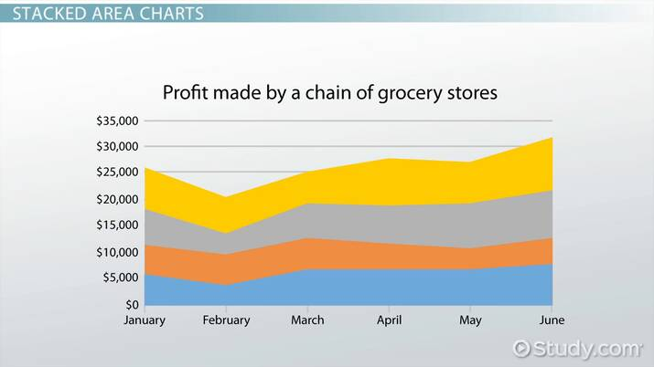
Visual Cues - Types
6. Area and Volume- Area charts
Bigger objects represent greater values- larger area means profit made by the grocery chain in yellow is higher than the one in grey and the one colored in blue makes the least profit
Notes:
When we use area and volume as visual cues, bigger objects represent greater values. For instance, length, area, and volume can be used to represent data with sizes (i.e. amount of space) in either two or three dimensional space. When we use circles (i.e. two dimensional spaces) or spheres (i.e. three dimensional space) as shape visual cues, we can also use different sizes of circles or spheres to represent different data values.

Slide 19
Visual Cues - Types
7. Colour
SPOT THE BEAR!
Color as a visual cue helps us break camouflage and differentiate things visually from their surroundings
Notes:
Colour, as a visual cue, helps us break camouflage because things differ visually from their surroundings only by their colours. For example, if we have colour vision, we can easily see that there is a black bear in the above figure. If we do not have colour vision, it will be much harder for us to spot the black bear. Clearly, this can be a life-or-death decision for the hunters or for a person who walks in the jungle.
The role that colour plays ecologically suggests ways that it can be used in data visualisation. Colour is good for labelling and categorisation, but poor for displaying shape, detail or space.

Slide 20
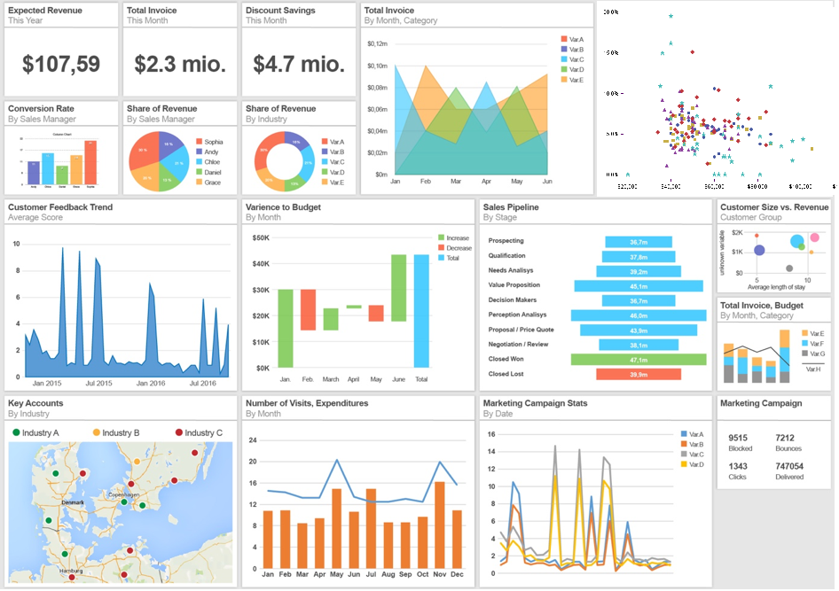
Class Discussion 1
Can you identify the components of visual cues on the dashboard ?
Source: https://dapresy.com/wp-content/uploads/2016/07/Image-4.png;
http://www.sas-sr.com/intro_sas/mercredi/major.PNG

Slide 21
Class Discussion 1
Can you identify the components of visual cues on the dashboard ?
Colour
Shape
Angles
Length
Area and Volume
Position
Direction
Source: https://dapresy.com/wp-content/uploads/2016/07/Image-4.png;
http://www.sas-sr.com/intro_sas/mercredi/major.PNG

Slide 22
Coordinate Systems

Slide 23
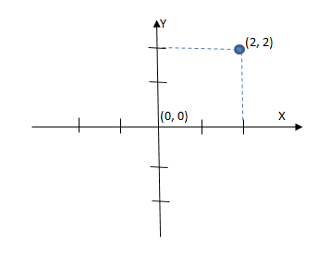
Coordinate Systems - Types
The cartesian coordinate system
Two fixed perpendicular reference lines- x-axis and y-axis
Both axes meet at a point, called the origin (0,0)
The numerical coordinates are the signed distance from the origin
Notes:
The cartesian coordinate system specifies each data point on a plane by a pair of numerical coordinates. The numerical coordinates are the signed distances from the data point to the two fixed perpendicular reference lines, which are measured in the same unit of length. These reference lines are called x- axis and y-axis. Both axes meet at a point, called the origin, which is usually represented by ordered pair (0, 0). The numerical coordinates can also be expressed as a signed distance from the origin.
We can also use the same concept to define the position of any data point in n-dimensional space by n cartesian coordinates. The coordinates are the signed distance from the data point to the n fixed perpendicular reference lines which are measured in the same unit of length.

Slide 24
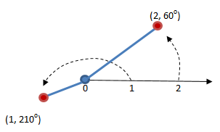
Coordinate Systems - Types
The polar coordinate system
The fixed point (0,0) is called the pole
The ray or half-line from the pole in the fixed direction is called the polar axis
Each data point is determined by the distance and an angle
Notes:
The polar coordinate system is a two-dimensional coordinate system. Each data point is determined by the distance between a fixed point and an angle from a fixed direction. The fixed point, which is analogous to the origin in the cartesian coordinate system, is called the pole. The ray or half-line from the pole in the fixed direction is called the polar axis. The distance from the pole is called the radial coordinate or radius, and the angle is called the angular coordinate, polar angle or azimuth. This coordinate system is less used than the cartesian coordinate system, but it is useful in cases where the angle or direction is important.
Polar coordinates are often used in navigation. An aircraft uses a slightly modified version. Polar coordinates make calculation easier for physicists and engineers— they are used in representing electrical fields, magnetic fields and temperature fields.

Slide 25
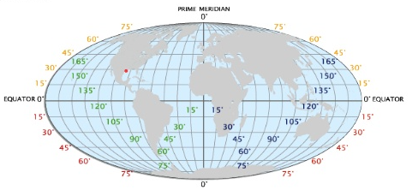
Coordinate Systems - Types
The geographic coordinate system
Represents every location on the earth using latitude and longitude
Latitude lines run east and west
Longitude lines run north and south
Elevation can be thought of as a third dimension (height above sea level)
Notes:
The geographic coordinate system is a coordinate system that enables every location on the earth to be specified by a set of numbers or letters. To represent the location, the coordinate system commonly uses latitude and longitude —- angles relative to the equator and the prime meridian, respectively. Sometime the coordinate system may also use elevation.
Latitude lines run east and west, which indicates north and south positions on the globe. Longitude lines run north and south, which indicates east and west positions. Elevation can be thought of as a third dimension. Analogous to the cartesian coordinate system, the latitude is like the horizontal axis, and the longitude is like the vertical axis.

Slide 26
Scales

Slide 27
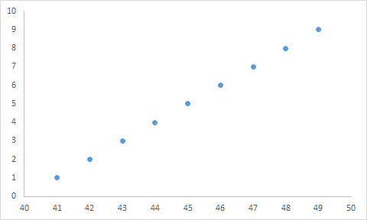
Scales - Types
Linear Scale
Visual spacing between each of the data points is the same regardless where the data points are on the axis
Source: https://www.google.com/search?q=examples+of+linear+scales&rlz=1C1GCEA_enSG969SG969
Notes:
In a linear scale, the visual spacing between each of the data points is the same regardless of where the data points are on the axis.
For example, a customer relationship manager of an apparel company would like to visualise customer satisfaction with the company’s products. He can use the linear Scale (i.e. 0 representing very disappointed and 5 representing very satisfied) to visualise the data. If we were to measure the distance between two data points on the lower end of the linear scale, it would be the same as the distance between two data points on the higher end of the linear scale.

Slide 28
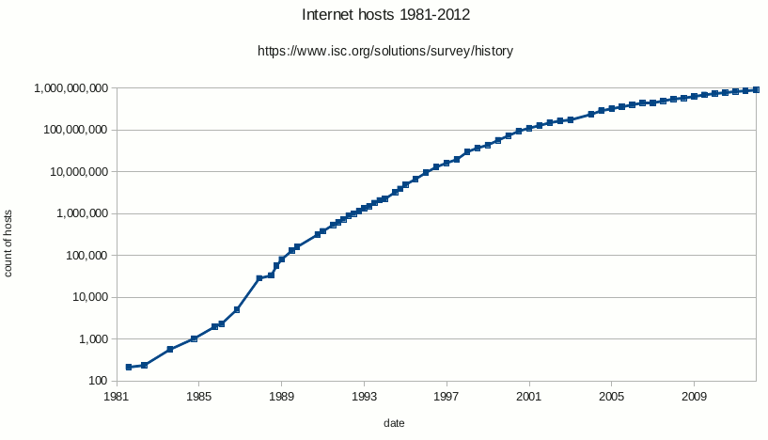
Scales - Types
Logarithmic scale
Takes very large, exponentially growing numbers and displays them in a way that is easier for the brain to understand
Is used when numbers multiply by a factor larger than 2 from one time interval to another
Source: https://en.wikipedia.org/wiki/Logarithmic_scale
Notes:
The logarithmic scale condenses the distance between each of the data points when the value of the data points increase. This scale is useful if we are interested to visualise the percentage difference or the rate of change amongst each of the data points, especially when the data has a wide range.
The linear scale shows the absolute number of sales over time, while the logarithmic scale shows the rate of change of the sales amount over time. By visualising the data using the logarithmic scale, it is much clearer that the rate of change is constant. Although the logarithmic scale is extremely useful, it is not easily understood by all.

Slide 29
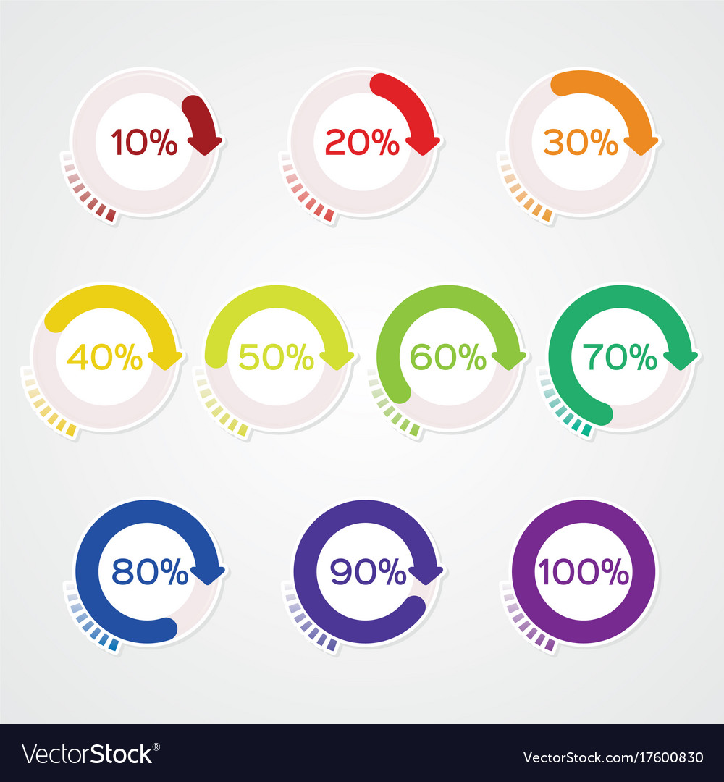
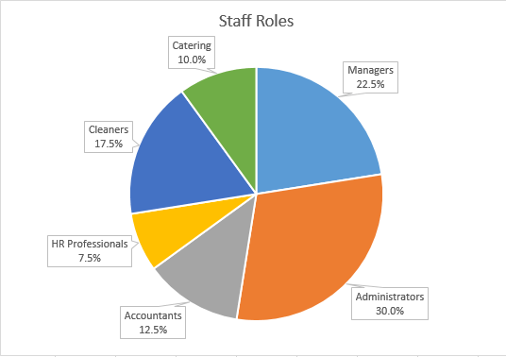
Scales - Types
Percent scale
It is used to represent part of the whole data, its maximum is 100 percent
Source: https://www.skillsyouneed.com/num/percentages.html
Notes:
Percent scale is usually linear, but when it is used to represent part of the whole data, its maximum is 100%. In addition, the sum of percentages should not exceed 100%.

Slide 30
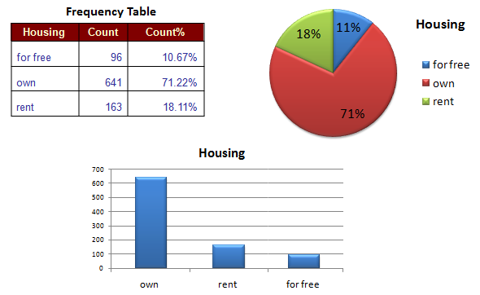
Scales - Types
Categorical scale
Example: The housing variable with the three categories
for free
own and
rent
Source: https://www.saedsayad.com/categorical_variables.htm
Notes:
We use categorical scales when we want to provide visual separation of categorical data, such as country of residence or gender. The categorical scale often works with a linear scale or a logarithmic scale.

Slide 31
Scales - Types
Time scale
Used to plot temporal data on a linear scale, or to divide the temporal data on a categorical scale, such as by year, month or day
Notes:
We use the time scale when we want to plot temporal data on a linear scale, or to divide the temporal data into a categorical scale, such as by year, month or day. When communicating data to the audience, the time scale gives us the advantage of lending the reader connection, because time is a part of everyday life.

Slide 32
Context

Slide 33
Context
The big idea
Context is a data visualisation component that lends to better understanding of who, what, when, where and why of the data
Focus-context problem in data visualisation
The viewer needs both overview and details of the information simultaneously
Information needed in the overview may be different from that needed in the detail
Need to combine both types within a single interactive data visualisation
Notes:
Context can make the data clearer for interpretations. When we would like to enable data visualisation viewers to see the data visualisation object of primary interest in full detail, and at the same time get an overview within the context (i.e. surrounding information) available, this is what we call a focus-context problem in data visualisation. Card et al. (1999) explained that a focus-context problem starts from three premises: First, the viewer needs both context (i.e. overview of the information), and focus (i.e. detail of the information) simultaneously. Second, the information needed in the overview may be different from that needed in detail. Third, these two types of information need to be combined within a single interactive data visualisation.
A focus-context data visualisation therefore allows viewers to have the information of interest in the foreground and all the remaining information in the background which are simultaneously visible (i.e. seeing the trees without missing the forest). The focus-context problem is not always a spatial related problem. There are also structural and temporal related problems.
We are fortunate that the human brain is able to integrate detailed information from successive fixation of the fovea, with the less detailed information that is available at the periphery of vision. This is combined with the information that comes from the prior sequence of fixations. For each new fixation, our brain will somehow match the key objects in the previous view with those same objects that are moved to new locations. Differing level of details is supported in normal perception because objects are seen at much lower resolution at the periphery of vision than in the fovea. In addition, we have no difficulty in recognising objects at different distances, which means that scale-invariance operations are supported in normal perception. Therefore, solutions to the focus context problem are found by taking advantage of these perceptual capabilities.
There are four different visualisation techniques to solve the focus context problem: distortion, rapid zooming, elision, and multiple windows.

Slide 34
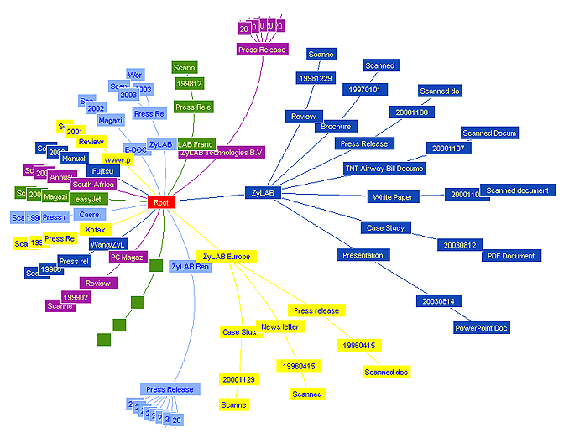
Context
Solving the focus-context problem - distortion
Spatially distorts the data presentation to give more room to the designated points of interest, and to decrease the space given to regions away from those points
Hyperbolic Tree Browser
Source: https://zylab.files.wordpress.com/2010/09/hyperbolic_tree.png
Notes:
The distortion technique spatially distorts a data presentation to give more room to the designated points of interest, and to decrease the space given to regions away from those points. What is of specific interest is spatially expanded at the expense of what is not, thus providing both focus and context. The above figure shows one of such methods called hyperbolic tree browser (Lamping et al., 1995), where parts of the graph are dynamically repositioned and resized based on selected points of interest. The selected node is expanded to show its content.

Slide 35
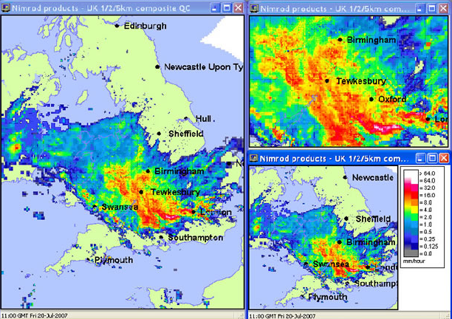
Context
Solving the focus-context problem - rapid zooming
Allows viewers to zoom rapidly in and out of points of interest
Source: http://www.ceh.ac.uk/sites/default/files/hyrad-static-and-rapid.jpg
Notes:
The rapid zooming technique allows viewers to zoom rapidly in and out of points of interest. This technique provides a large information landscape, even though only a part of them is visible in the viewing window at any one time. This means that the focus and context are not simultaneously available, but viewers can move rapidly and smoothly from focus to context and vice versa.

Slide 36
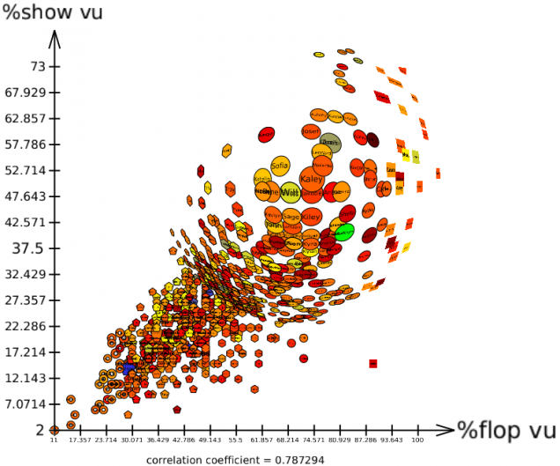
Context
Solving the focus-context problem - elision
Hides parts of a structure from viewers until they are needed
Elision – Fish Eye Technique
Source: http://tulip.labri.fr/TulipDrupal/sites/default/files/uploadedFiles/images/scatterplot_view_detail_fisheye.preview.png;
Notes:
The elision technique hides parts of a structure from viewers until they are needed. Typically, this can be achieved by collapsing a large graphical structure into a single graphical object. This technique can be applied to text as well as to graphics. The above figure illustrates the generalised, fish-eye technique of viewing data (Furnas, 1986), where lesser and lesser detail is shown as the distance from the focus of interest increases.

Slide 37
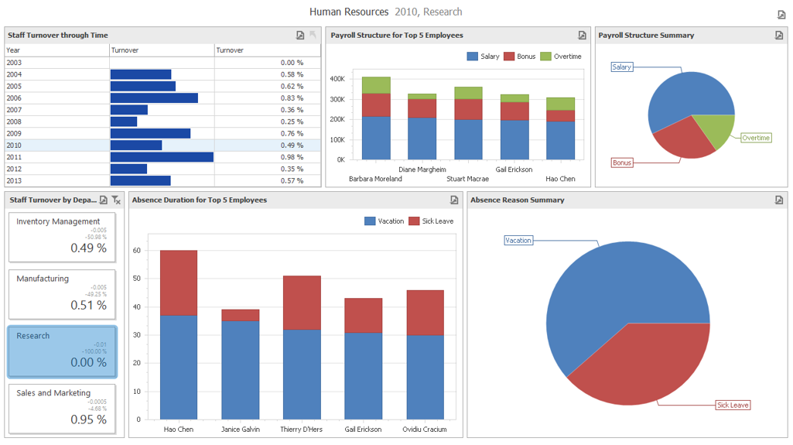
Context
Solving the focus-context problem - multiple windows
Allows viewers to have one window that shows an overview of the data, and several other windows that show the expanded details
Source: https://www.devexpress.com/products/net/dashboard/i/demos/winforms-hr-dashboard.png
Notes:
The multiple windows technique allows viewers to have one window that shows an overview of the data, and several other windows that show the expanded details. The major perceptual problem with the multiple windows technique is that detailed information in one window is disconnected from the overview (i.e. the context) as shown in another window. A solution for this problem is to use lines or transparent overlay to connect the boundaries of the zoomed window to the source window.
The advantage of the multiple windows technique over the others listed previously is that this technique will not distort the object. It is able to show the focus and the context simultaneously.

Slide 38
Class Activity: Data Visualisation Evaluation

Slide 39
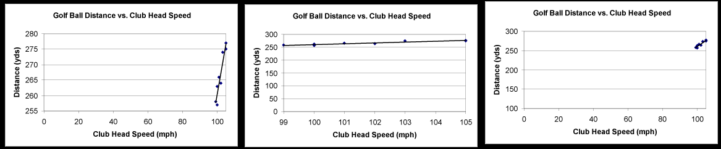
Class Activity Task
Sit with your GBA’s team mates (optional)
Discuss why the plots/charts are bad visualisation example and suggest ways to improve the plots/charts.

Slide 40
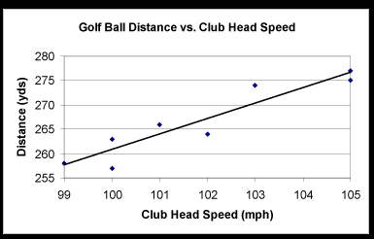
Class Activity Task
Source: http://www.faculty.virginia.edu/ASTR3130/lablinks/GuidePlots.html

Slide 41
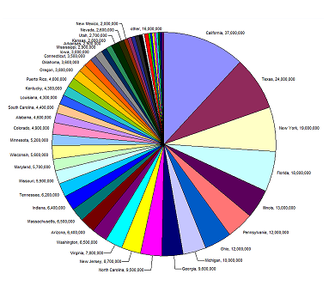
Source: http://www.eea.europa.eu/data-and-maps/daviz/learn-more/chart-dos-and-donts; http://www.mathworks.com/matlabcentral/mlc-downloads/downloads/submissions/35277/versions/3/previews/html/Pie_Chart_2D_2_01.png

Slide 42
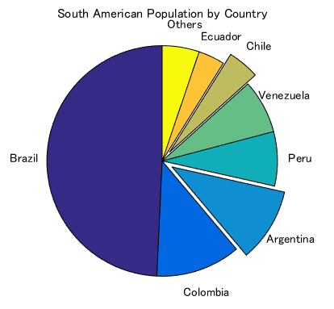
Source: http://www.eea.europa.eu/data-and-maps/daviz/learn-more/chart-dos-and-donts; http://www.mathworks.com/matlabcentral/mlc-downloads/downloads/submissions/35277/versions/3/previews/html/Pie_Chart_2D_2_01.png

Slide 43
Tableau (Class Activity)

Slide 44
Tableau (Class Activity)
Sit in your GBA groups (optional)
Ensure that you have a working copy of Tableau Desktop installed on your computer
Ensure that you have the following datasets downloaded onto your computer:
global_superstore_2016.xlsx
Sales 2016.xlsx
Products 2016.csv
Coffee Chain.xlsx
Office City.xlsx

Slide 45
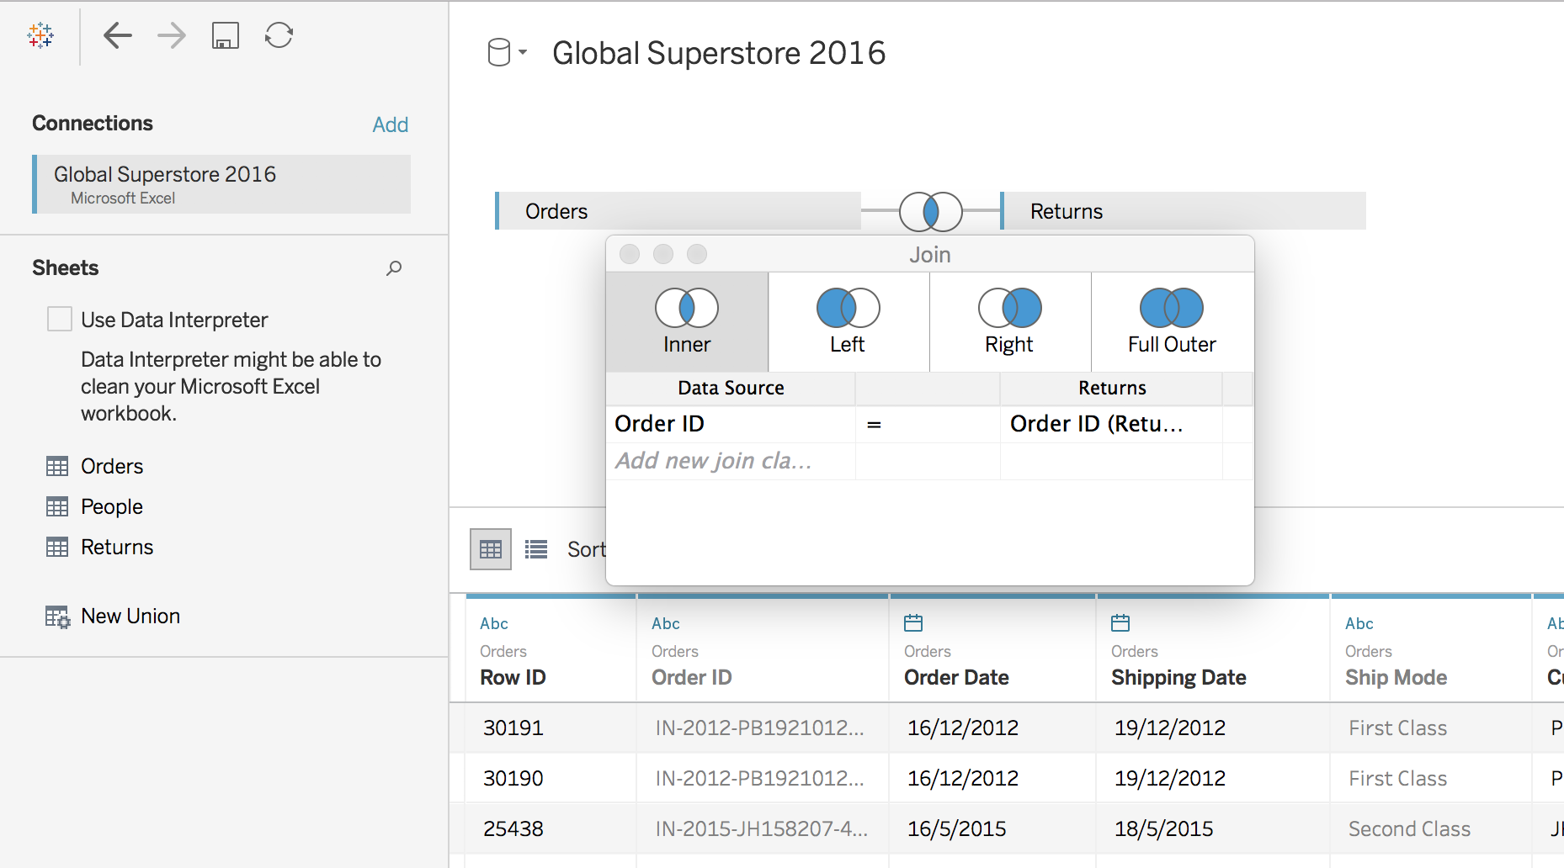
Table Join
Connect to data: Global Superstore 2016
Drag Orders to right side
Double click Orders
Drag Returns to right side, next to Orders
The default join type is inner join. Order ID is set to be the key for join
Notes:
Demonstrate how different tables can be joined, and illustrate the difference between inner, left, right and outer joins.

Slide 46
Table Join
Join Type | Result
Inner | The resulting table contains values that have matches in both source tables. When a value doesn't match across both source tables, it is dropped entirely.
Left | The resultant table contains all values from the first source table and corresponding matches from the second source table. When a value in the first source table doesn't have a corresponding match in the second source table, you see a null value in the resulting table.
Right | The resultant table contains all values from the second source table and corresponding matches from the first source table. When a value in the second source table doesn't have a corresponding match in the first source table, you see a null value in the resulting table.
Full outer | The resultant table contains all values from both the source tables. When a value from either source table doesn't have a match with the other table, you see a null value in the resultant table.
Notes:
Demonstrate how different tables can be joined, and illustrate the difference between inner, left, right and outer joins.

Slide 47
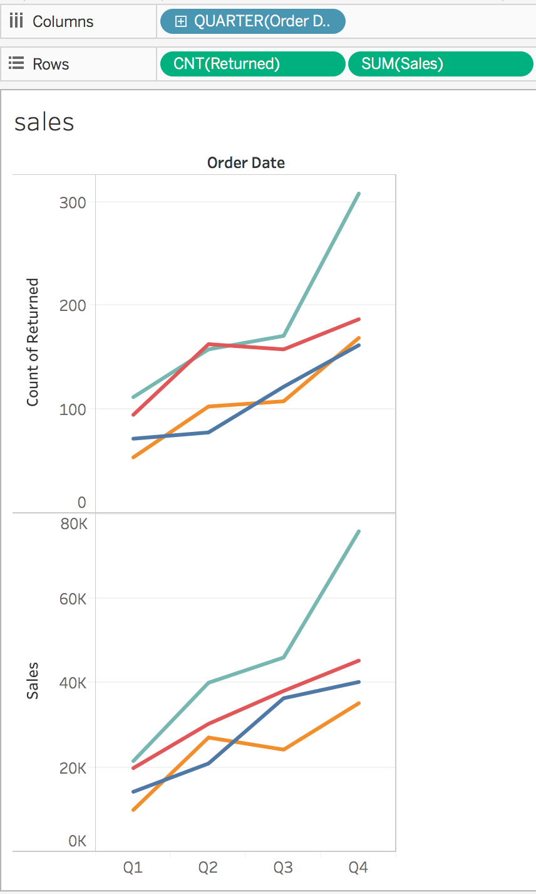
Table Join – Joined Visual
Add visual
Order date ➔ Columns
Click “+” sign before Year and move Year to color
Returned ➔ Rows
Switch Returned Measure ➔ count
Sales ➔ Rows

Slide 48
Cross-database Join
Go to home page, connect to Sales 2016
Go to Data Source, click “Add” under connections
Text Files Products 2016
Double click “Sheet1” on the right
Drag “Products 2016.csv” to the right
Drag “Sales” to the right
Go to a new worksheet
Notes:
Demonstrate join using different databases (Sales and Products 2016 data sets).

Slide 49
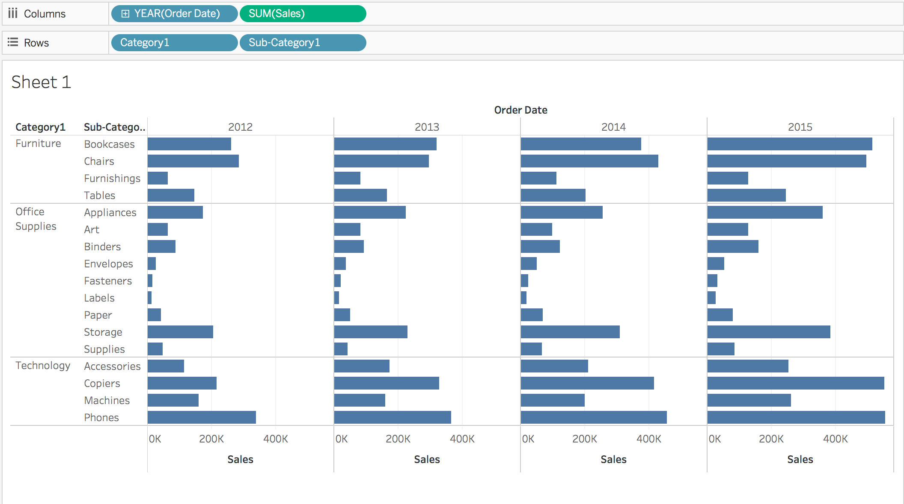
Cross-database Join

Slide 50
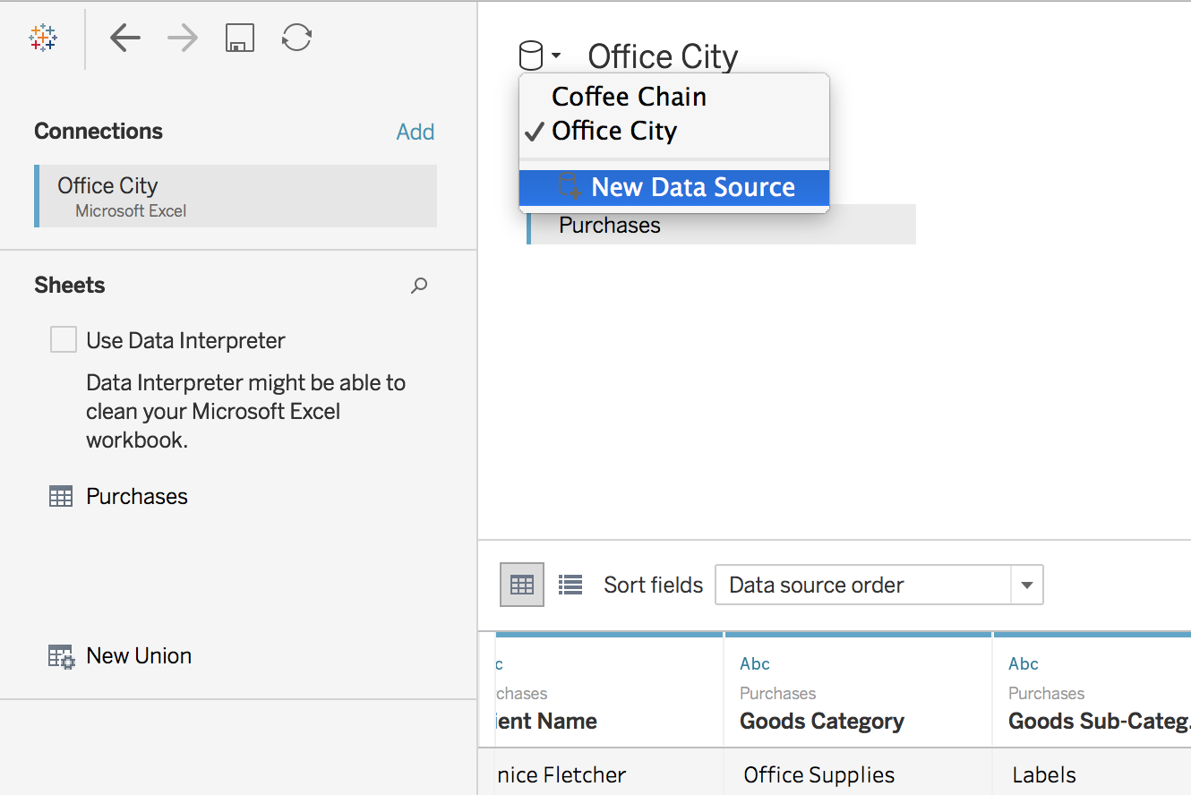
Data Blending
Go to home page,
Connect to Office City
Connect to Data Source
Go to a new worksheet
More info:
https://help.tableau.com/current/pro/desktop/en-us/multiple_connections.htm

Slide 51
Data Blending
Data: Office City, Sales (Office City) Columns
State (Office City) Rows
Data: Coffee Chain, Sales (Coffee Chain) Columns
New Calculation
IIF(ISNULL(SUM([Sales (Sheet1)])),
Sum([Sales]),
SUM([Sales]) + SUM([Sales (Sheet1)]) )
Call it Total
Discuss to identify:
Primary and Secondary data sources
Notes:
Illustrate the difference between data blending and regular joins

Slide 52
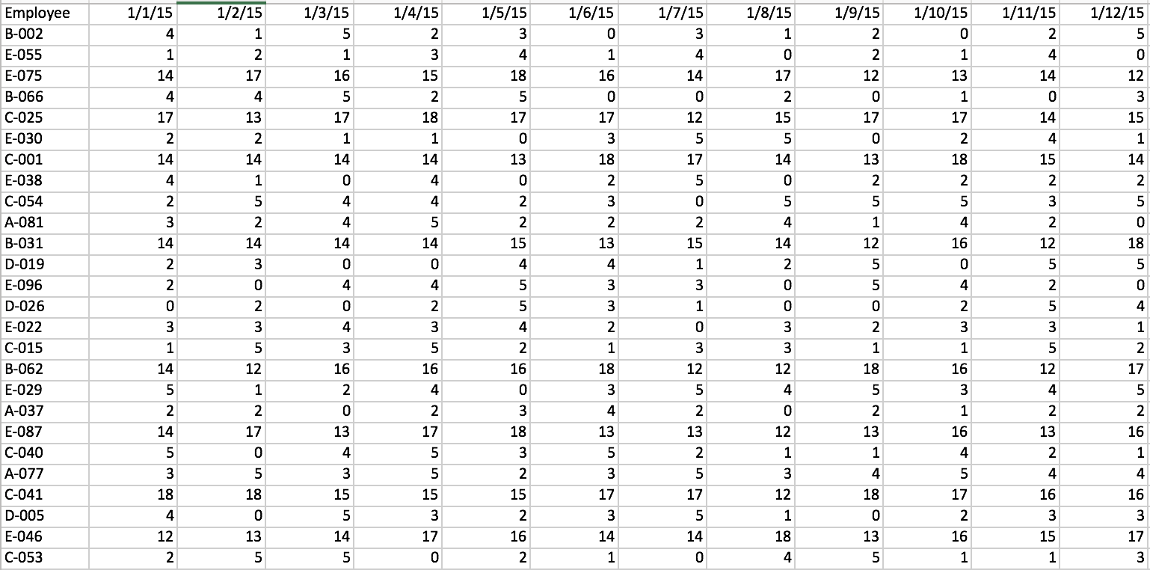
Pivot Data from Columns to Rows
Pivot from wide format to long format
Go to home page, connect to data_prep_flights.xlsx
More info:
https://help.tableau.com/current/pro/desktop/en-us/pivot.htm
Notes:
Make use of data_prep_flights.xlsx (resolved incidents) to demonstrate how a wide format can be pivoted to long format.

Slide 53
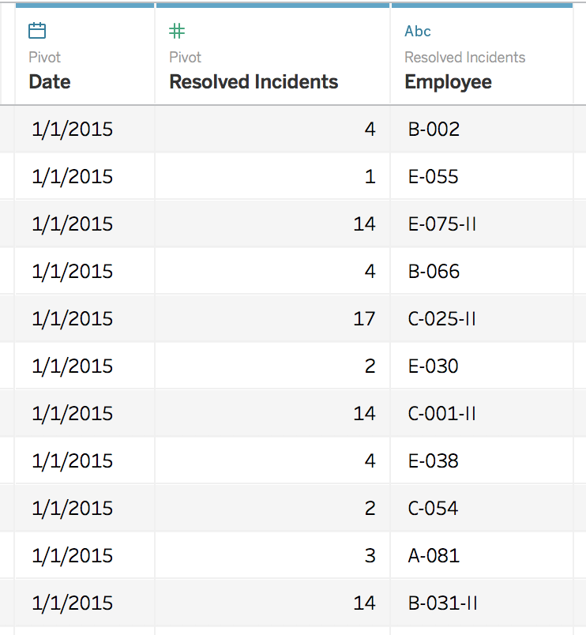
Pivot
Pivot from wide format to long format
To long format, date as rows:
Select all the date columns
Click “Pivot”
Rename the columns
Notes:
highlight all the date columns and then click “pivot”

Slide 54
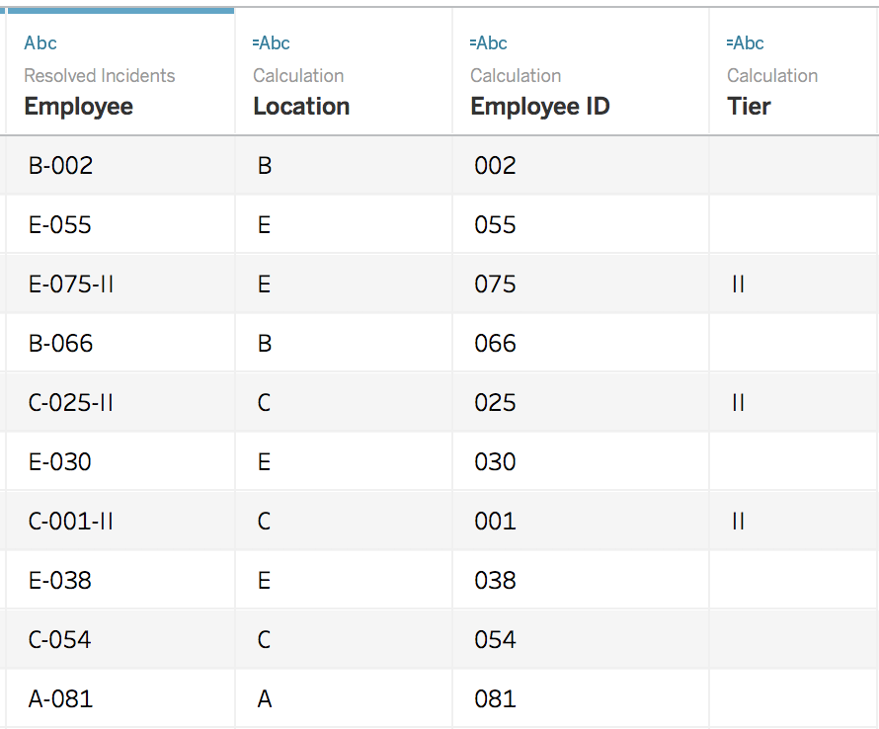
Split
Split “Employee” column
Select “Employee” column, select “Custom Split”
Use the separator “-”, and split off “All”
Rename the new columns
Notes:
Click on Employee column and Split

Slide 55
Split
Sort
Notes:
Use the generated column from split to create a chart.
Mouse in top middle bar graph to sort the bar graph by length of bars

Slide 56
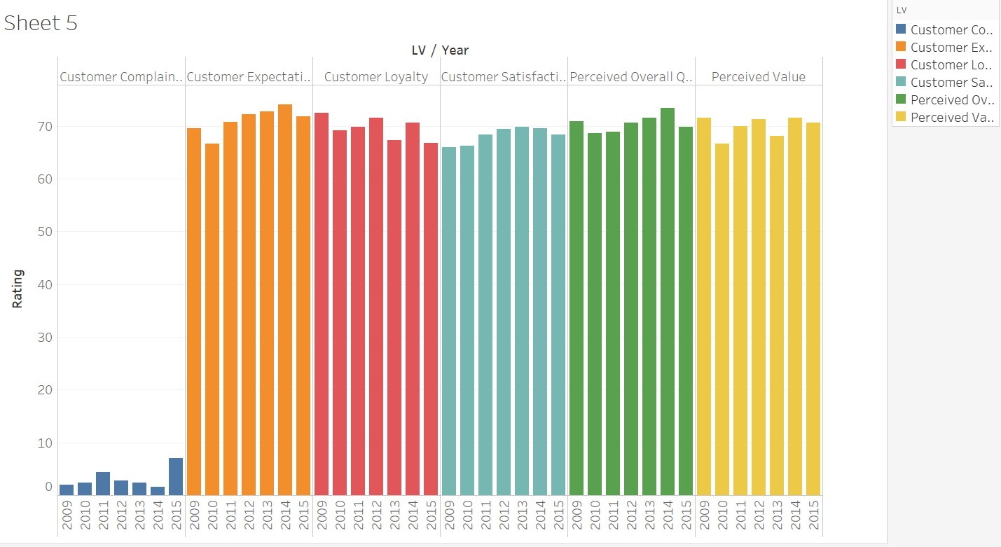
Exercise
Use the dataset, survey_results_wide_format (survey_results)
Pivot the dataset from wide format to long format
Create the following chart

Slide 57
Tableau (Class Activity)
Sit with your GBA’s teammates (optional)
Follow your instructor for the following exercises:
Data:
global_superstore_2016.xlsx (orders)
Coffee Chain.xlsx and Office City.xlsx

Slide 58
Calculation: Aggregate vs Record-Level
Building Measures
Data: Global_superstore_2016 (orders)
Notes:
Compare AVG and derived aggregated value, SUM/COUNTD sum of sales/number of distinct order
Compare AVG and derived aggregated value, SUM/COUNT sum of sales/number of order

Slide 59
Create a Calculated Field

Slide 60
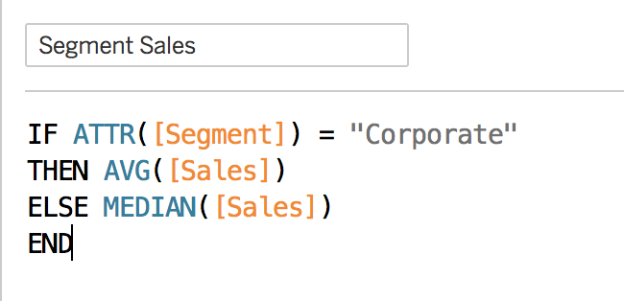
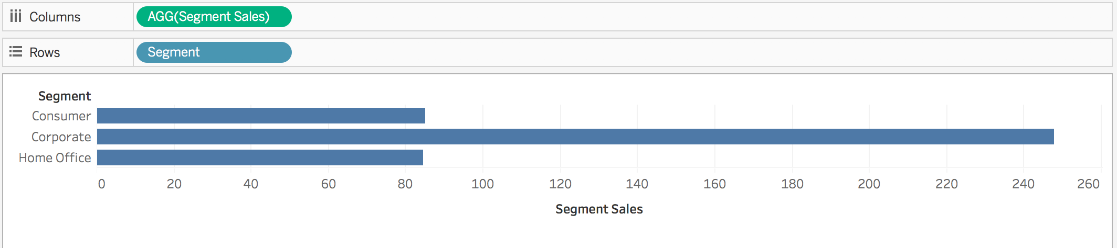
Aggregate Functions
Aggregation of a measure
Aggregation of a dimension
More information:
https://help.tableau.com/current/pro/desktop/en-us/calculations_aggregation.htm
https://help.tableau.com/current/pro/desktop/en-us/calculations_calculatedfields_aggregate_create.htm
Notes:
Part of this exercise is to illustrate the use of calculated field, and introduce students to some basic coding within Tableau.
Go through commonly used agg functions

Slide 61
Aggregate Functions
Attribute:
It can provide a way to aggregate dimensions when computing table calculations, which require an aggregate expression.
Using Attribute in a table calculation (optional). Example: https://help.tableau.com/current/pro/desktop/en-us/calculations_aggregation.htm#aggregating-dimensions
Notes:
Part of this exercise is to illustrate the use of calculated field, and introduce students to some basic coding within Tableau.
Go through commonly used agg functions
Another way to view a dimension is to treat it as an Attribute. Do this by choosing Attribute from the context menu for the dimension. The Attribute aggregation has several uses:
It can ensure a consistent level of detail when blending multiple data sources.
It can provide a way to aggregate dimensions when computing table calculations, which require an aggregate expression.
It can improve query performance because it is computed locally.
Tableau computes Attribute using the following formula:
IF MIN([dimension]) = MAX([dimension]) THEN MIN([dimension]) ELSE "*" END
The formula is computed in Tableau after the data is retrieved from the initial query. The asterisk (*) is actually a visual indicator of a special type of Null value that occurs when there are multiple values. See Troubleshoot Data Blending(Link opens in a new window) to learn more about the asterisk.

Slide 62
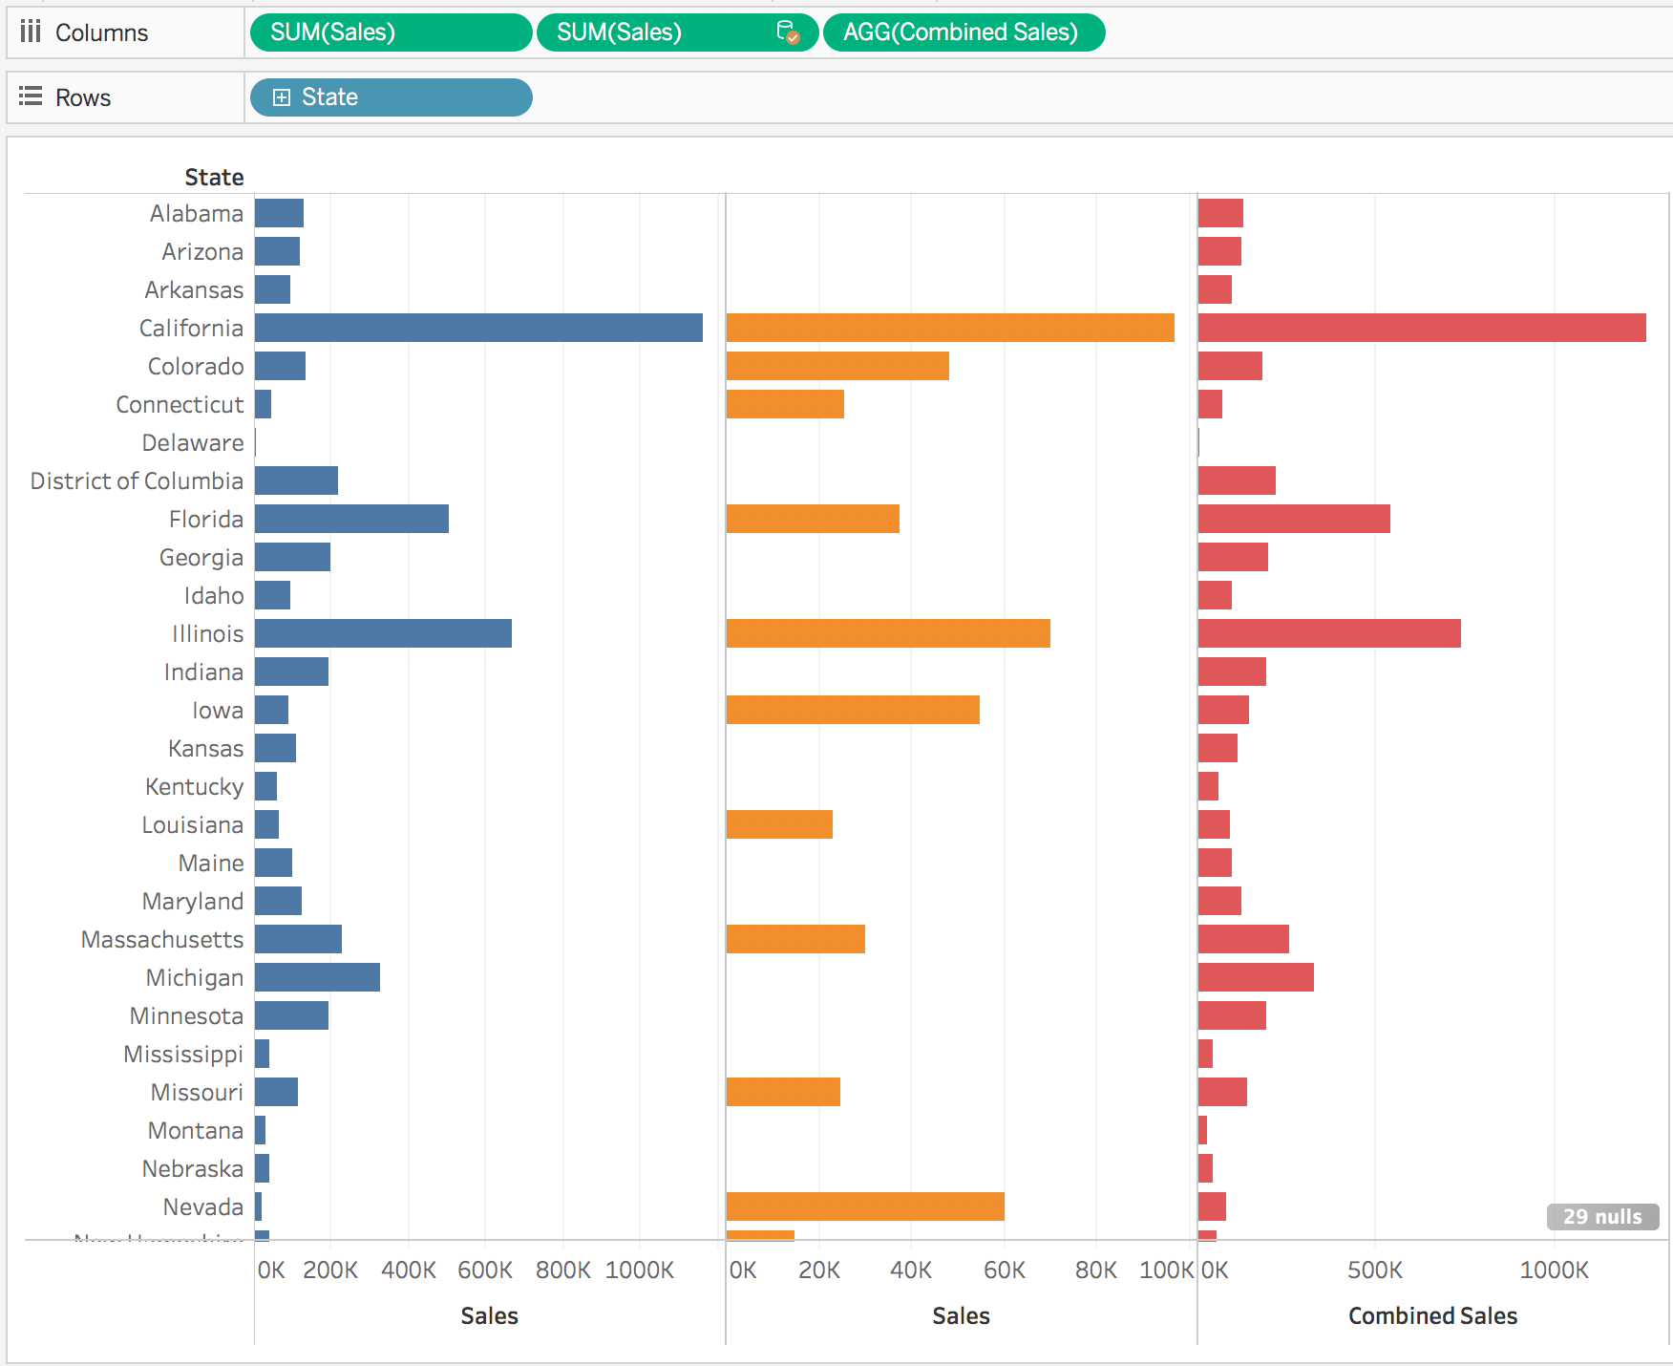
Exercise
Use the data Office City and Coffee Chain
Apply data blending to show the sales from Office City (primary data) and Coffee Chain
Create a calculated field: for each state, calculating combined sales from office city.xlsx and coffee chain.xlsx
Notes:
Illustrate how the sales figure from the 2 different data sets can be combined based on the state name.

Slide 63
Exercise
Create a calculated field: for each state, calculating combined sales from office city.xlsx and coffee chain.xlsx
Go to Data, Office City, then create a calculated field
ZN() This returns the expression if it is not null; otherwise, it returns zero.
Change the color in “Marks” for each of the “Sales” columns

Slide 64
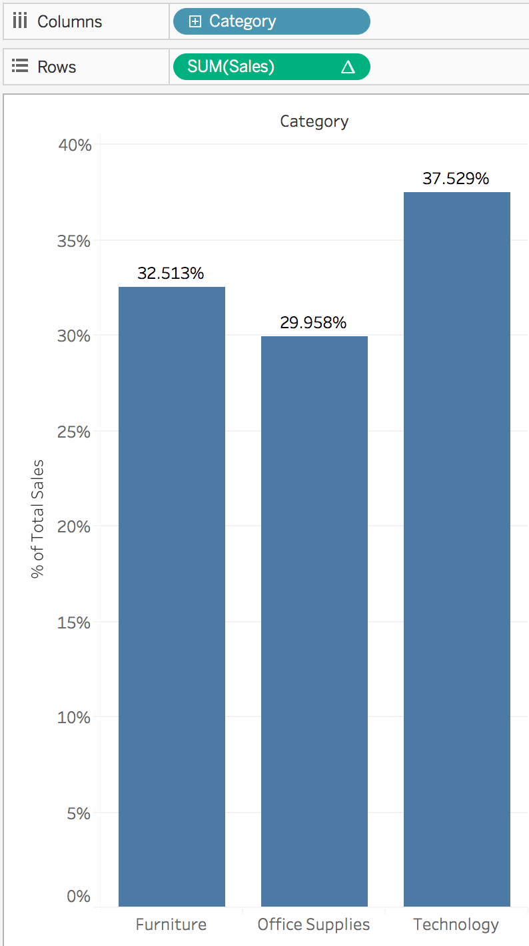
Quick Table Calculation
Percent of total
Data: Global_superstore_2016 (orders)
Sales → Rows
Category → Columns
Go to “Rows” and select drop down menu of “Sum(sales)”.
Select “Add Table Calculation” and change Calculation Type to “Percent of total”.
Add mark label: press and hold control then drag sum(sales) delta to “Label” in Marks
Notes:
Make use of global_superstore_2016.xlsx (orders) for this exercise to guide students on the use of quick table calculation.
Go to “Rows” and select drop down menu of “Sum(sales)”.
Select “Add Table Calculation” and change Calculation Type to “Running total”.

Slide 65
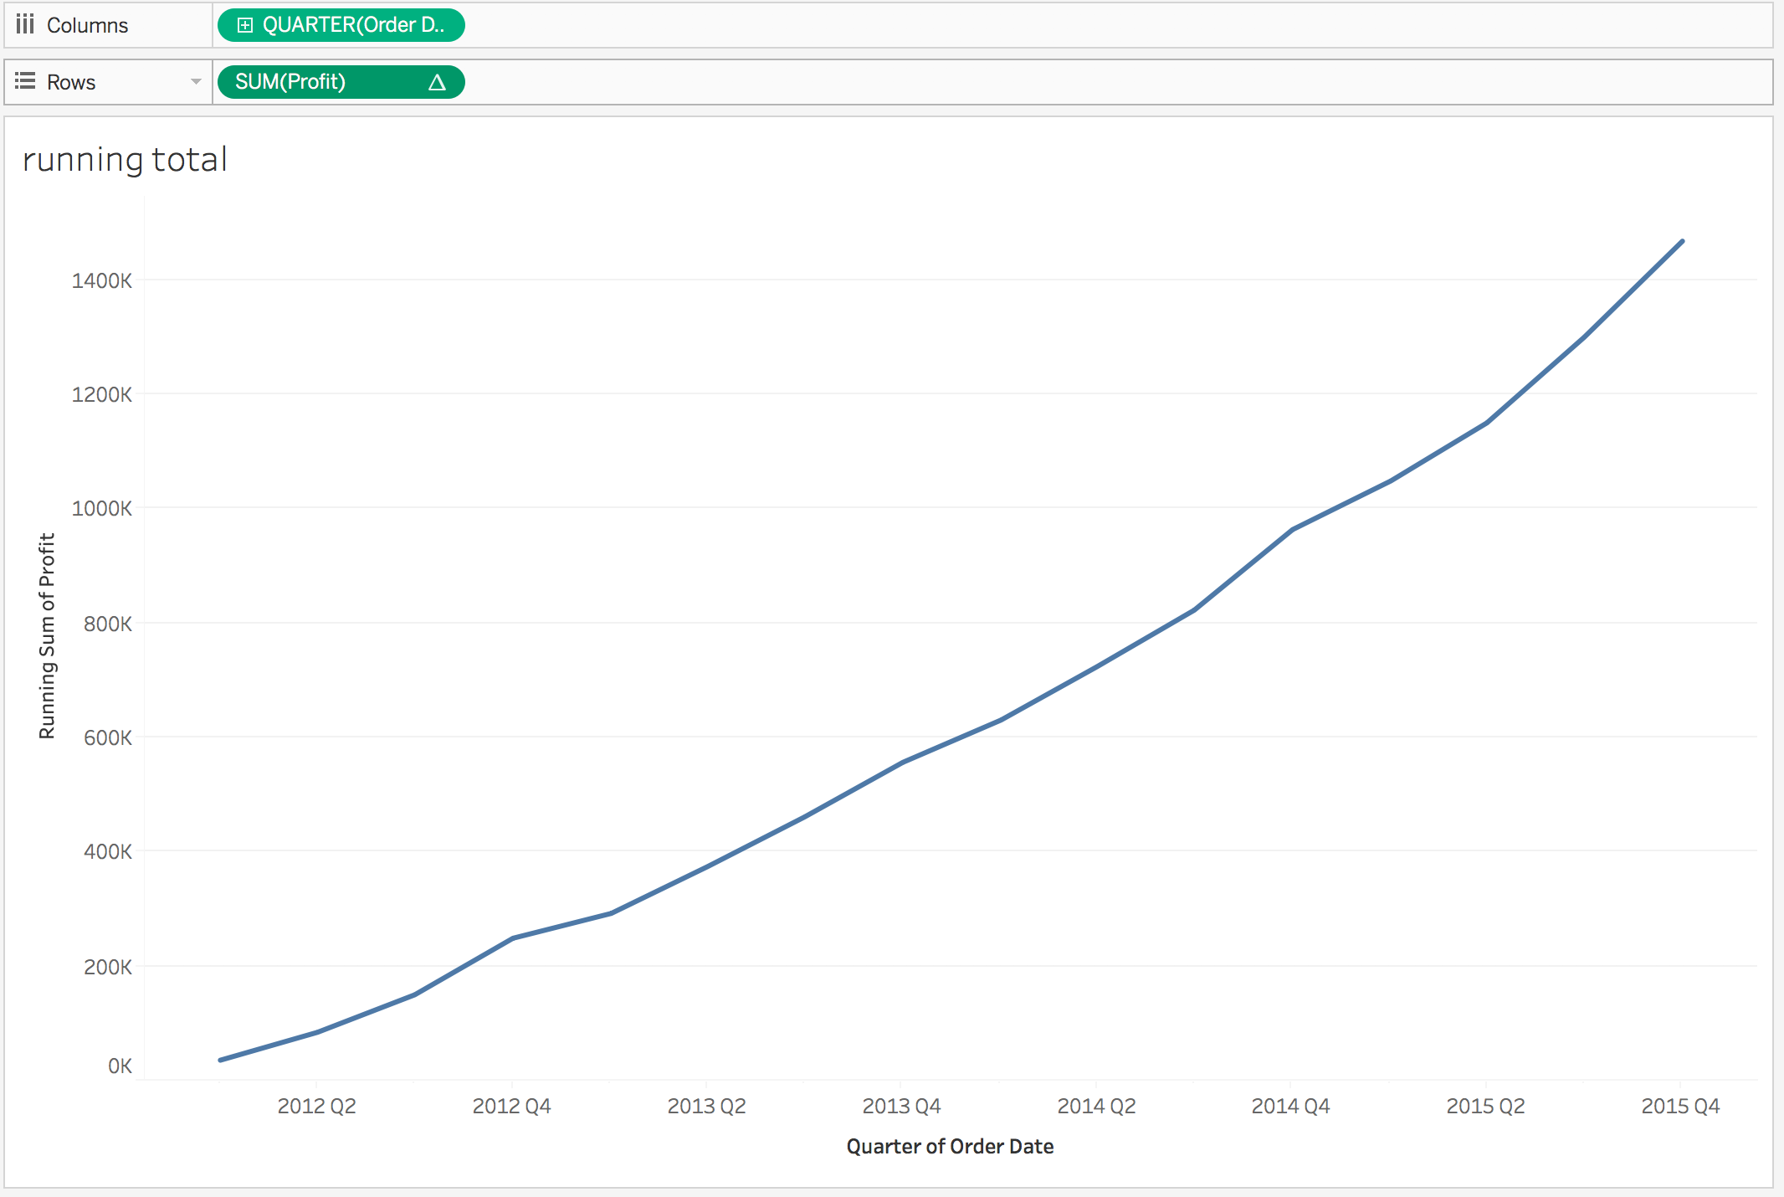
Quick Table Calculation
Running total: apply when one dimension is time

Slide 66
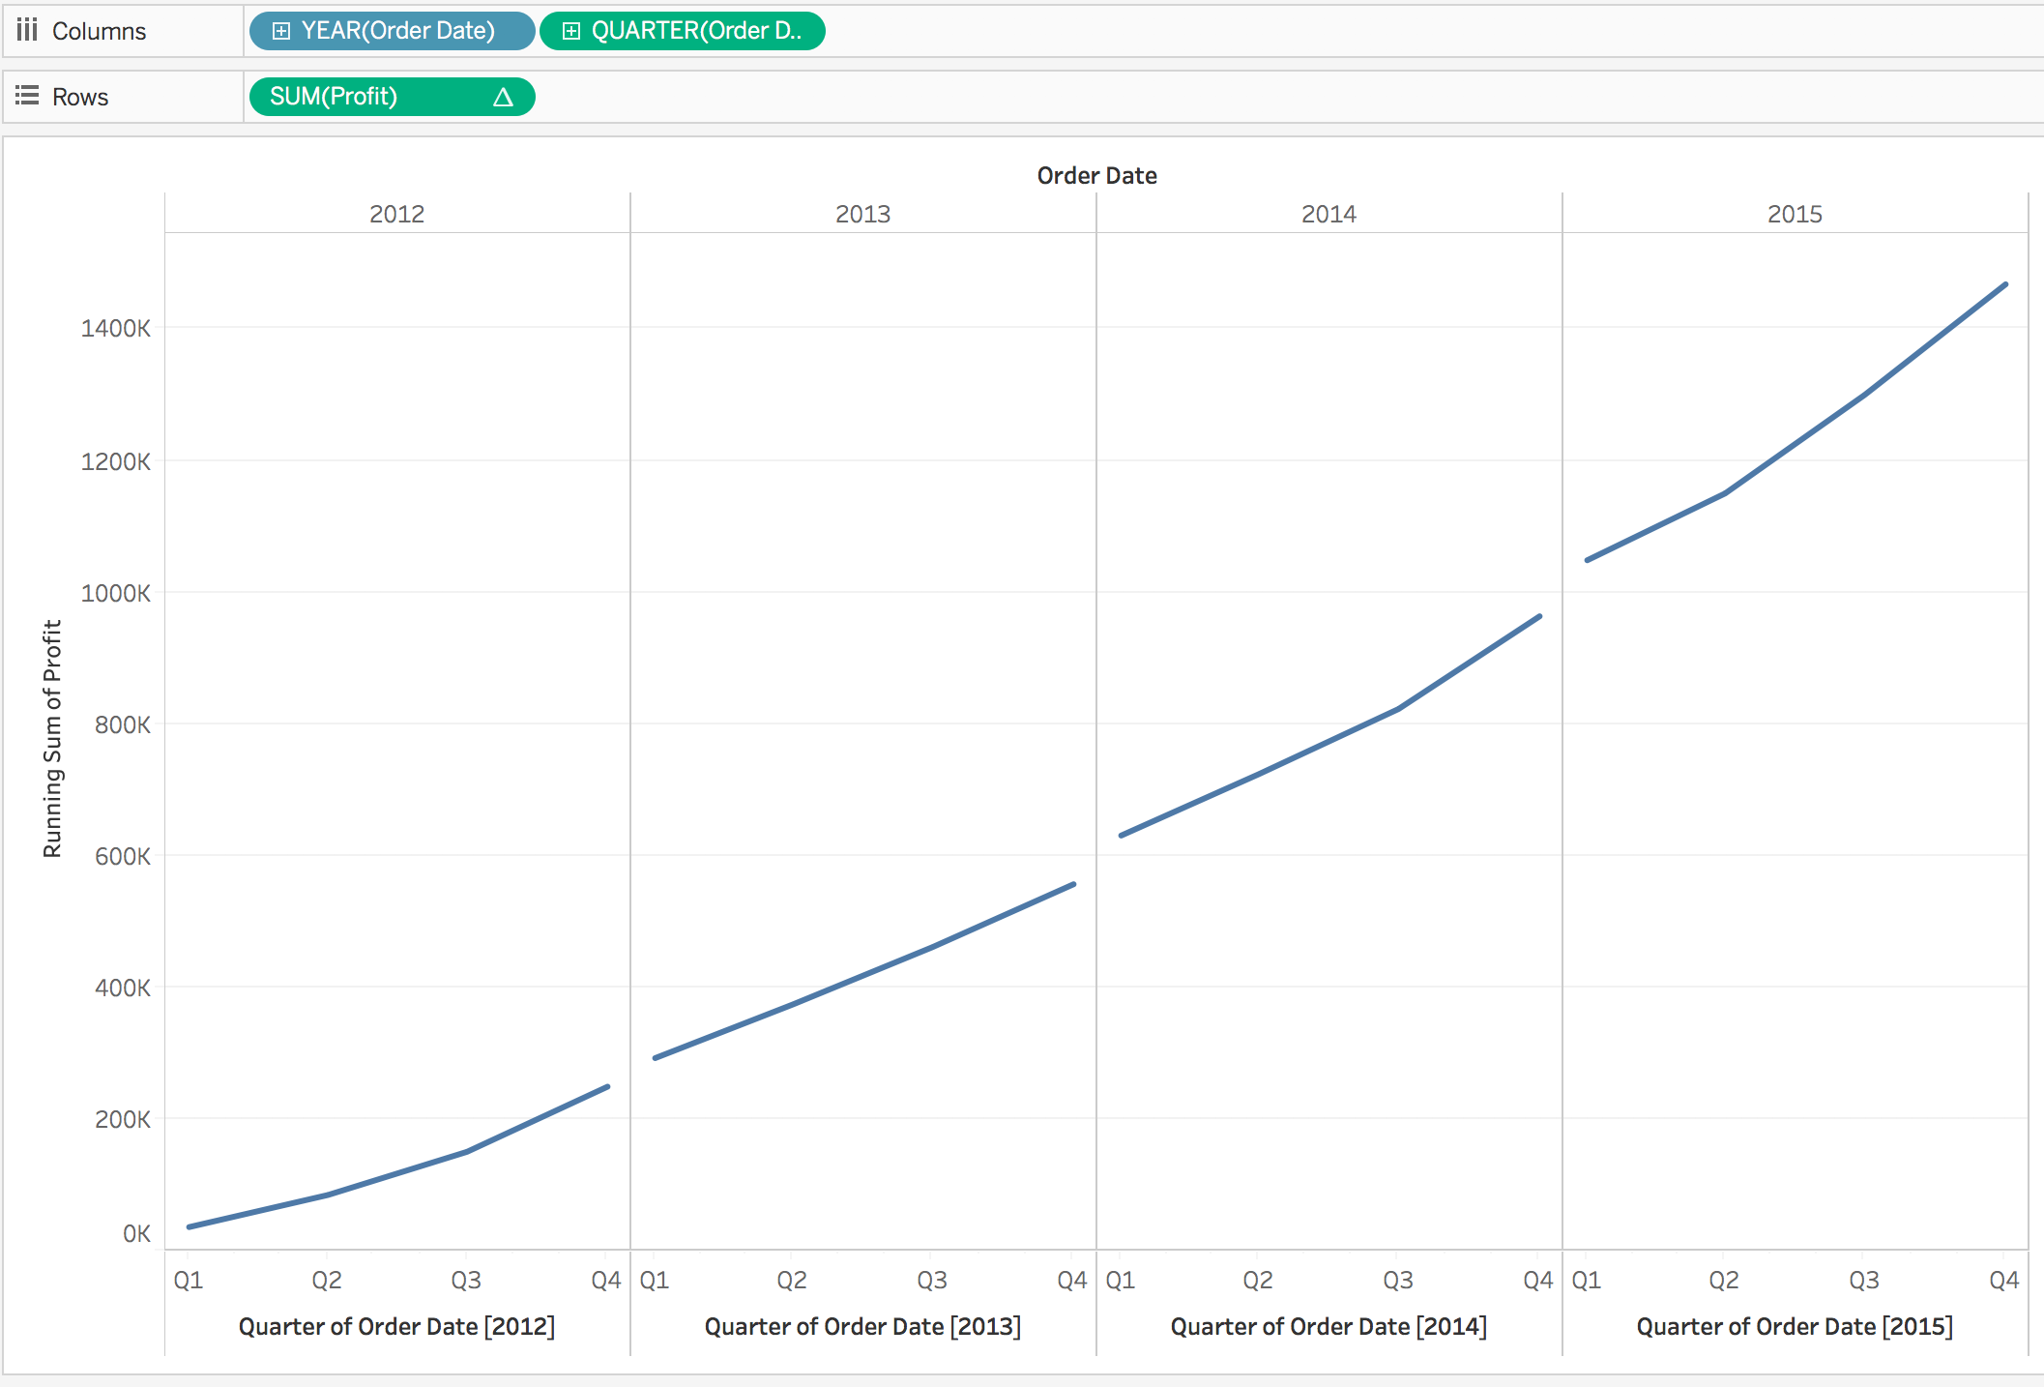
Quick Table Calculation
Running total for each year: Is this chart correct?

Slide 67
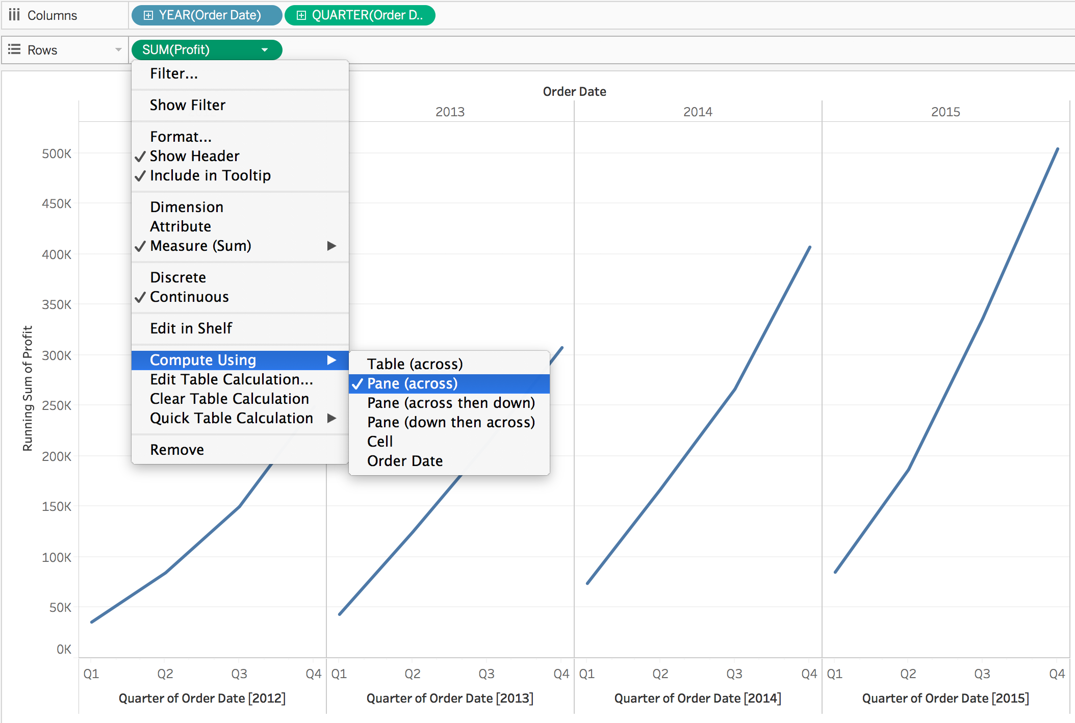
Quick Table Calculation
running total for each year:
Notes:
Illustrate the differences between the different options under “Compute Using”

Slide 68
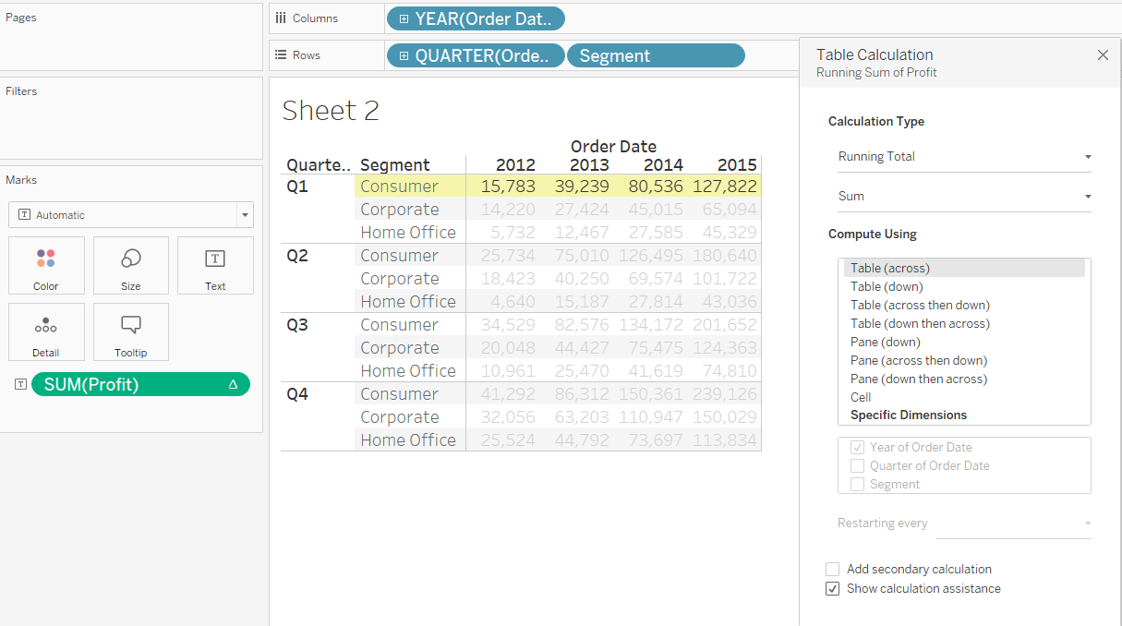
Quick Table Calculation
Compare “Compute Using”:
Notes:
Illustrate the differences between the different options under “Compute Using”

Slide 69
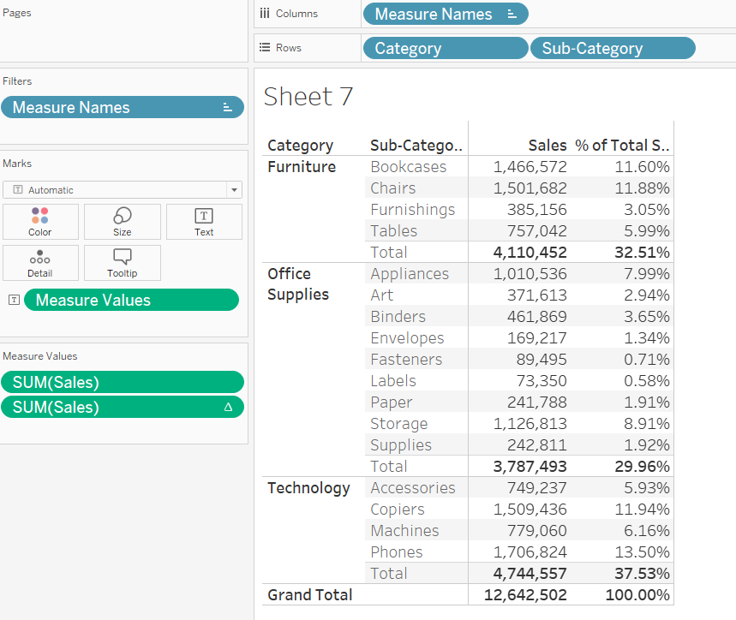
Quick Table Calculation
To have both sales and table calculations:
Category ➔Rows
Subcategory ➔Rows
Measure Names ➔Columns
Measure Values ➔Marks (Text)
Table calculation for SUM(Sales), percent of total
Drag another SUM(Sales) to Measure Values list
Remove unwanted measure values

Slide 70
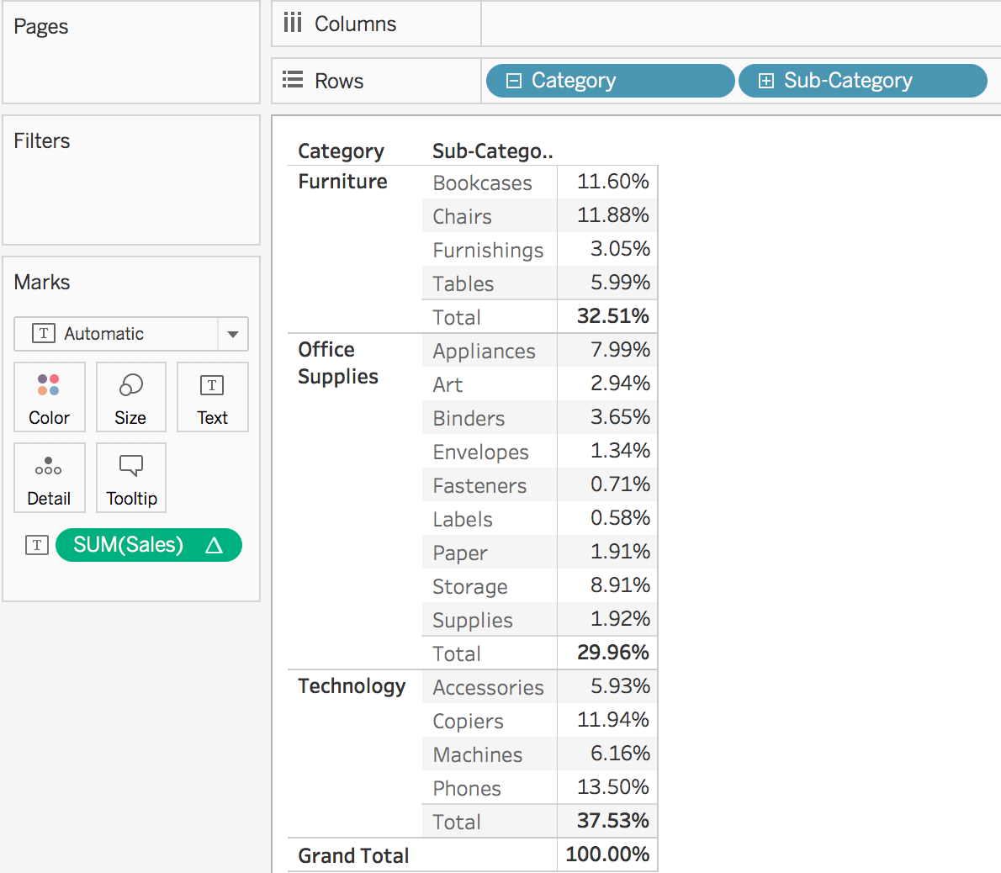
Exercise
Subtotal: Analysis ➔Totals ➔Add all subtotals
Percent of total
Grand Total: Analysis ➔Totals ➔Show column grand totals
More Information:
https://help.tableau.com/current/pro/desktop/en-us/calculations_tablecalculations.htm

Slide 71
Tableau File Extension
File Type | File Extension | Purpose
Tableau Workbook | .twb | It contains information on each sheet and dashboard that is present in a workbook. It has the details of the fields which are used in each view and the formula applied to the aggregation of the measures. It also has the formatting and styles applied. It also contains the data source connection information and any metadata information created for that connection.
Tableau Packaged Workbook | .twbx | This file format contains the details of workbook as well as the local data that is used in the analysis. Its purpose is to be share with other Tableau desktop or Tableau reader users assuming it does not need data from the server.
Tableau Data source | .tds | The details of the connection used to create the tableau report are stored in this file. In the connection details it stores the source type(excel/relational/sap etc.) as well as the data types of the columns.
Tableau Packaged Data source | .tdsx | This file is similar to the .tds file with the addition of data along with the connection details.
Tableau Data Extract | .tde | This file contains the data used in a .twb file in a highly compressed columnar data format. This helps in storage optimization. It also saves the aggregated calculations that are applied in the analysis. This file should be refreshed to get the updated data from the source.

